Slide 1
HOSPITAL BED & RESOURCE AVAILABILITY TRACKER
CAPSTONE PROJECT
Presented By:
Student Name- Vanshika Vaid
College Name- Daulat Ram College
Department – B.com(Hons)
4. AICTE ID- STU69c28e6d9bc7d1774358125

Slide 2
OUTLINE
Problem Statement (Should not include solution)
Proposed System/Solution
System Development Approach (Technology Used)
Algorithm & Deployment
Result
Conclusion
Future Scope
References

Slide 3
Problem Statement
Hospitals manage a large number of essential resources such as beds, equipment and other facilities on a continuous basis. However, information about resource availability, occupancy and maintenance status can be difficult to monitor and understand efficiently when it is not presented in a centralized and organized manner.
Lack of clear and timely visibility into resource status can make it difficult to identify available resources, occupied resources and resources under maintenance. This creates a need for better organization and monitoring of hospital resource information.

Slide 4
Proposed Solution
The proposed system provides a centralized, interactive tracker for monitoring hospital beds and essential resources.
Data Collection:
Use structured fictional/demo data on hospitals, resource types and current status.
Categorize resources as available, occupied or under maintenance.
Data Processing:
Organize and process data using Python and Pandas.
Apply hospital and resource-based filters for focused analysis.
AI/LLM Integration:
Integrate Gemini LLM via API key to generate plain-language resource summaries.
Provide filtered resource data to the AI for meaningful summaries.
Deployment:
Develop a user-friendly interactive app using Streamlit.
Run it locally through a Streamlit server for resource monitoring.
Evaluation:
Evaluate resource count accuracy, filter functionality and dashboard usability.
Test AI summaries for meaningfulness and accuracy.

Slide 5
System Approach
System Requirements
Python 3.x
Streamlit
Pandas
Google Gemini API
IBM Bob
Internet connection for Gemini API integration
Libraries / Tools Required
Streamlit — to build the interactive web application
Pandas — to manage and process hospital resource data
Google GenAI — to connect the application with Gemini
Python — for application development and data processing
IBM Bob — for AI-assisted project development

Slide 6
Algorithm & Deployment
Algorithm / AI Approach
AI Model Selection:
Google Gemini LLM generates natural-language summaries of hospital resource availability.
Selected to convert structured data into simple insights, not predict future values.
Data Input:
Hospital and resource data
Resource type
Status: Available, Occupied, Maintenance
Hospital-wise resource details
Dashboard-filtered data
Processing:
Organize data using Python and Pandas.
Send relevant data to Gemini via API.
Gemini analyzes the data and generates a concise summary.
AI Output:
Plain-language summary of current resource availability.
Highlights key trends and availability conditions.
Helps users understand data without manual interpretation.
Deployment:
Development: Python application developed with IBM Bob.
Interface: Streamlit interactive web app.
AI Integration: Google Gemini API.
Deployment: Runs through Streamlit server.

Slide 7
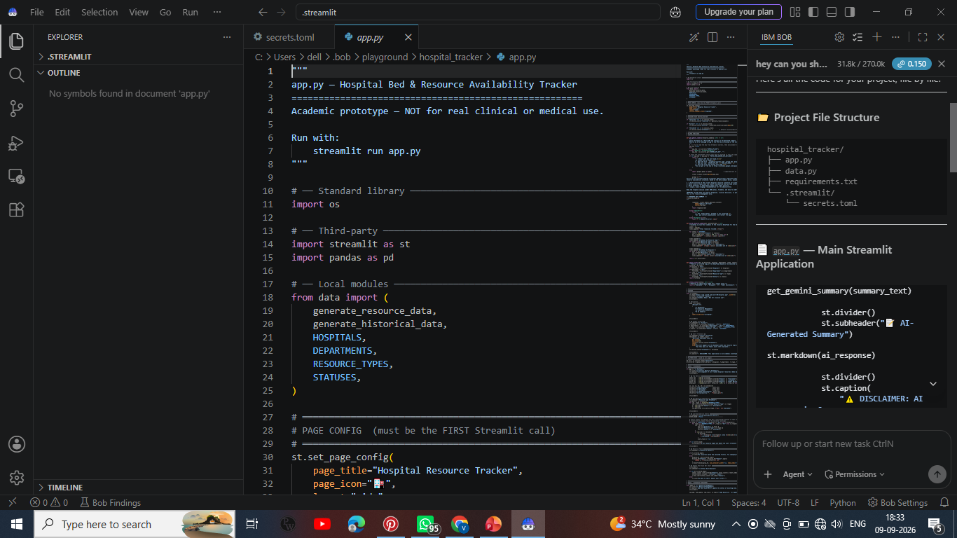
Result

Slide 8
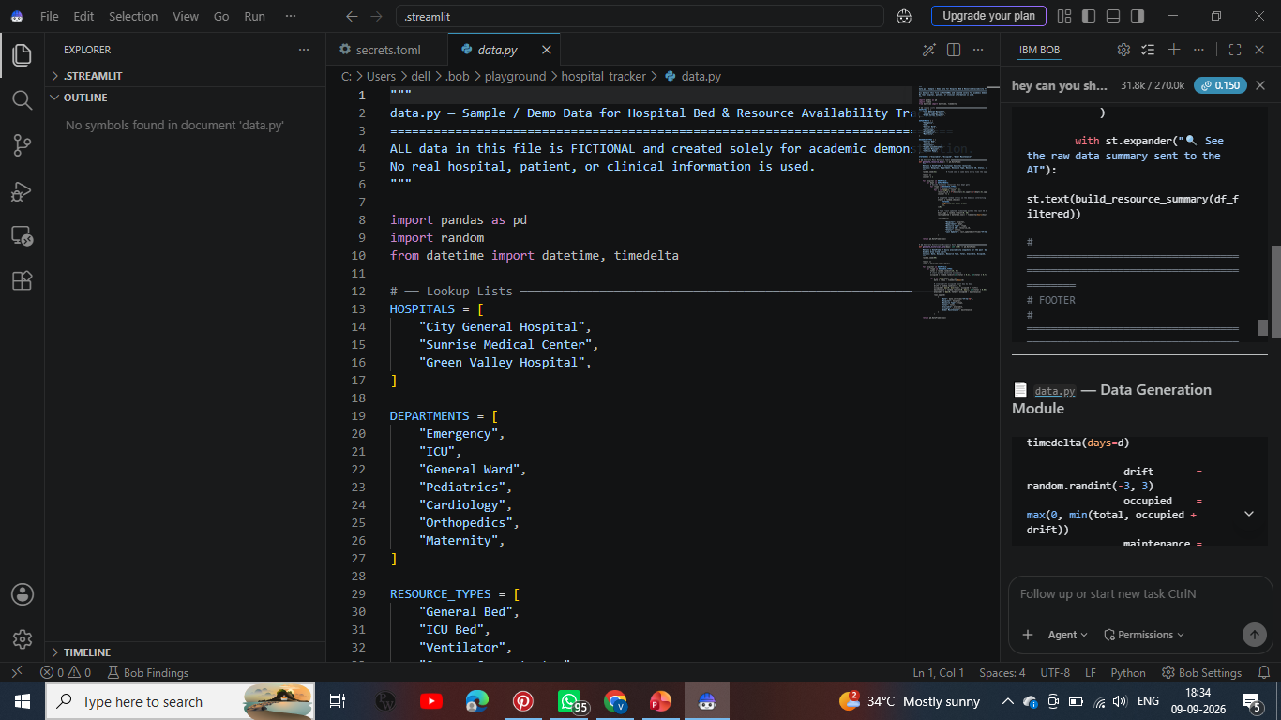
Result

Slide 9
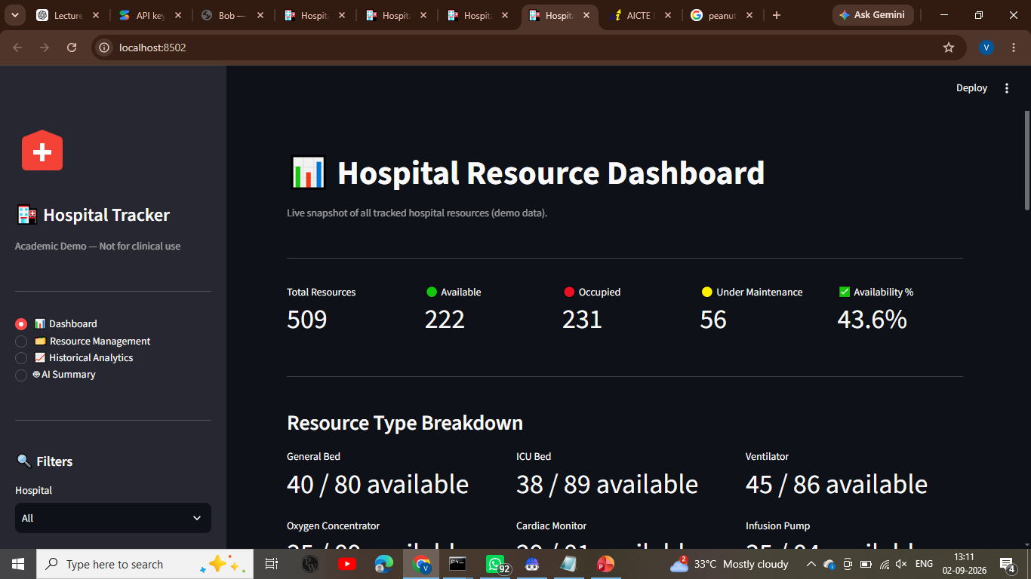
Result

Slide 10
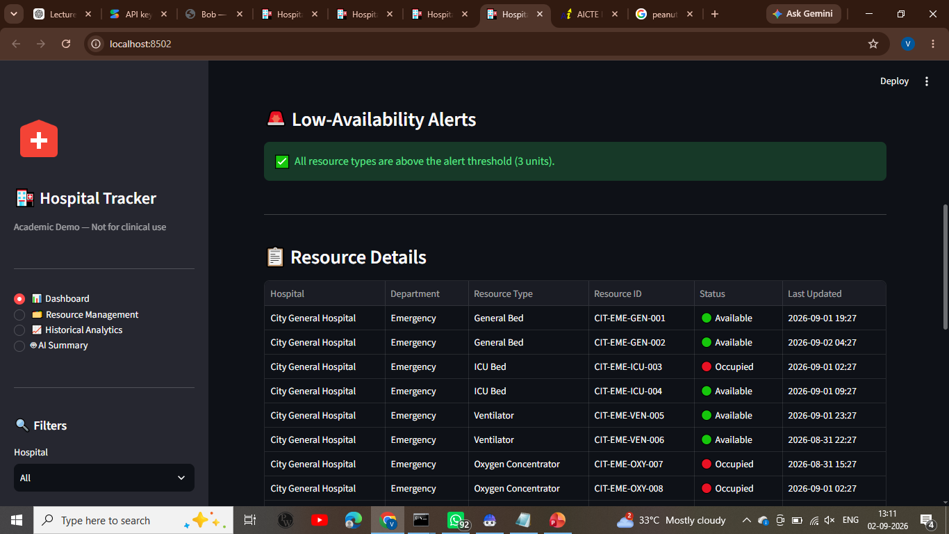
Result

Slide 11
Conclusion
The Hospital Bed & Resource Availability Tracker successfully provides a centralized and interactive way to monitor hospital resources.
The proposed solution effectively organizes resource information and presents availability, occupancy, maintenance status, and historical trends through an easy-to-use dashboard.
Integration of Google Gemini adds an AI-based summary feature that converts resource information into simple and understandable insights.
The project demonstrates how Python, Pandas, Streamlit, and Generative AI can be combined to improve resource monitoring.
Challenges Encountered
Integrating the Gemini API with the application.
Managing API key configuration and model compatibility.
Organizing and presenting resource data in a meaningful format.
Ensuring smooth interaction between the dashboard and AI Summary feature.
Future Improvements
Connect the system with real-time hospital databases.
Add real-time bed and equipment availability updates.
Include more hospitals and resource categories.
Add user authentication and data security.
Improve AI-based analysis with more detailed recommendations and alerts.

Slide 12
Future scope
Potential Enhancements
Real-Time Data Integration: Connect the system with live hospital databases to provide real-time bed and resource availability.
Predictive Analytics: Introduce machine-learning techniques to predict future bed occupancy and resource requirements.
Advanced AI Integration: Use advanced AI models to identify resource trends and provide intelligent recommendations.
Additional Data Sources: Incorporate patient admission, discharge, emergency, equipment and occupancy data.
Automated Alerts: Develop alerts for low bed availability, high occupancy and equipment maintenance.
Multi-Hospital Expansion: Expand the system to monitor resources across multiple hospitals and healthcare facilities.
Improved Security: Add authentication, access controls and stronger data-protection mechanisms.
Scalable Deployment: Deploy the application on a cloud platform for secure and wider access.
Future Vision
The system can evolve from a basic resource monitoring dashboard into an intelligent healthcare resource management and predictive decision-support system.

Slide 13
References
Python Documentation — Python Standard Library
https://docs.python.org/3/library/
Pandas Documentation — Data analysis and processing in Python
https://pandas.pydata.org/docs/
Streamlit Documentation — Framework for building interactive data applications
https://docs.streamlit.io/
Google Gemini API Documentation — Gemini models and API integration
https://ai.google.dev/gemini-api/docs
IBM Bob Documentation — AI-assisted software development
https://bob.ibm.com/docs/
GitHub — Code hosting and software development resources
https://github.com/

Slide 14
Deployment link / github link
Github Link: https://github.com/vanshika-vaid07/hospital-bed-resource-tracker
Streamlit : https://hospital-bed-resource-tracker-uufhamgsp5wdkcpt8ie9rj.streamlit.app/

Slide 15
THANK YOU

